Slide 1

JavaScript: Dates, Switch & Break
By Saara Uthmaan

Slide 2
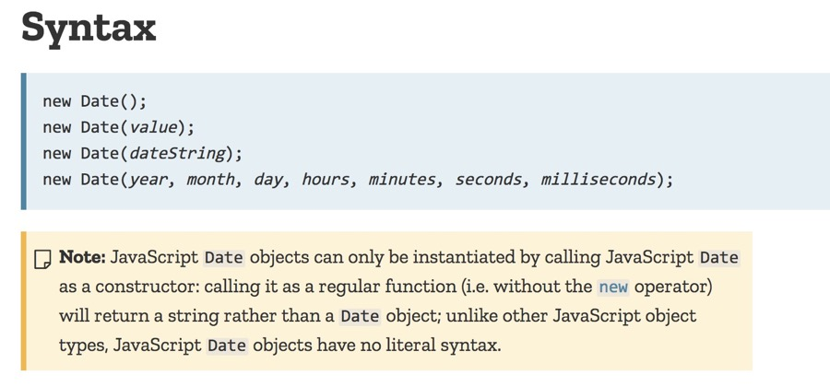
JavasCript Dates
Date Objects are static.
These objects are created with the constructor, new Date().
Months are counted using indexes, 0 = January and so on.
This Photo by Unknown Author is licensed under CC BY-SA

Slide 3
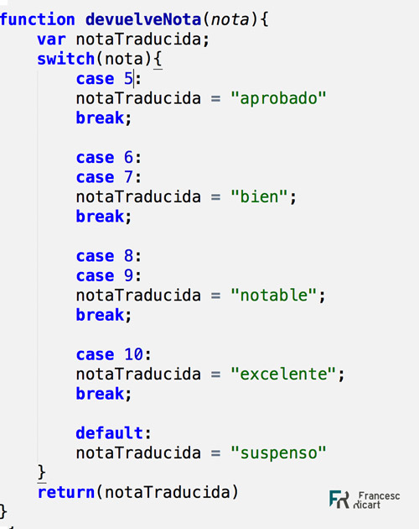
Javascript Switch
Switch statements allow for different outcomes to result from different actions.
There is a default option if none of the cases are met.
Some keywords used are : break and default
This Photo by Unknown Author is licensed under CC BY-SA-NC

Slide 4
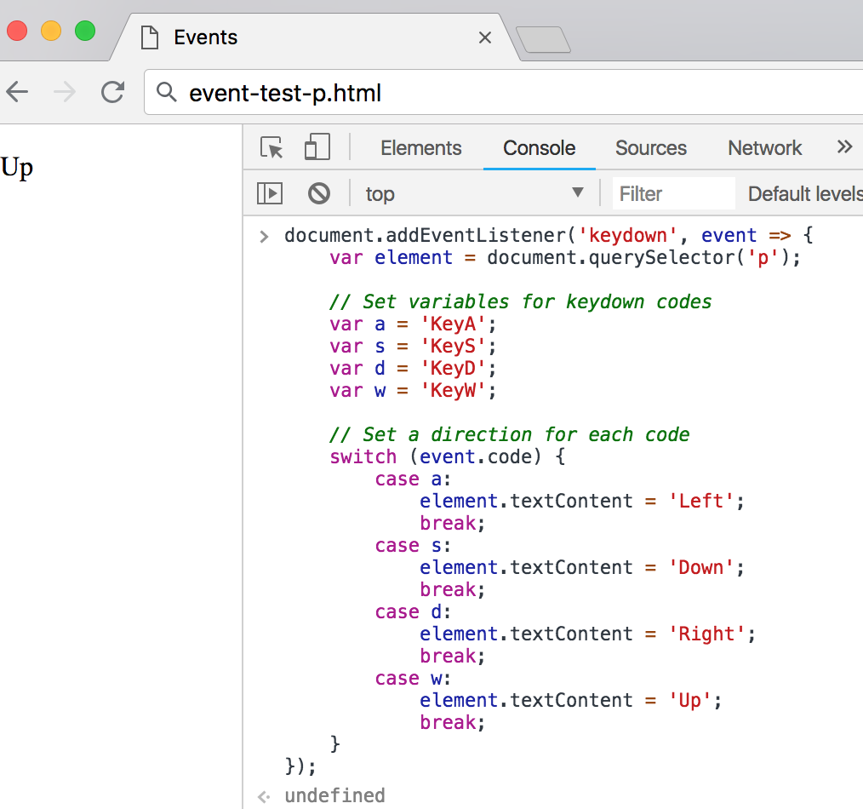
Javascript Break
Break plays the role of jumping out of a loop or ending the loop.
In JavaScript, the continue statement is used inside loops to skip the current iteration and move to the next iteration of the loop, effectively skipping any remaining code in the loop block for that specific iteration.
This Photo by Unknown Author is licensed under CC BY-SA-NC

